Slide 1

Introduction
This MySQL project focuses on analyzing India’s trade data between 2010 and 2021, including both imports and exports across various sectors. The objective of this project is to store, manage, and analyze large volumes of trade data efficiently using MySQL database techniques. By organizing the data into structured tables and applying SQL queries, the project aims to extract meaningful insights regarding trade trends, major trading partners, sector-wise performance, and year-on-year growth.
The database is designed to handle key attributes such as trade values, commodities, countries involved, and time periods. Through the use of joins, aggregations, filtering, and indexing, the project demonstrates how relational database systems can be used for real-world data analysis. It also highlights how MySQL can support decision-making by enabling quick and accurate retrieval of information.

Slide 2

Objective
Overall Trade Analysis: To examine the overall trend of India’s imports and exports over the selected period and identify patterns of growth, decline, and stability.
Major Sectors Identification: To analyze different sectors (such as agriculture, manufacturing, petroleum, etc.) and determine their contribution to India’s total trade.
Trade Deficit Evaluation: To identify years with trade deficits and analyze the gap between imports and exports to understand economic implications.
Surge in Exports: To detect periods of significant increase in exports and study the factors contributing to such growth.
Major Export and Import Sources: To identify key trading partners of India and analyze which countries contribute most to imports and exports.

Slide 3
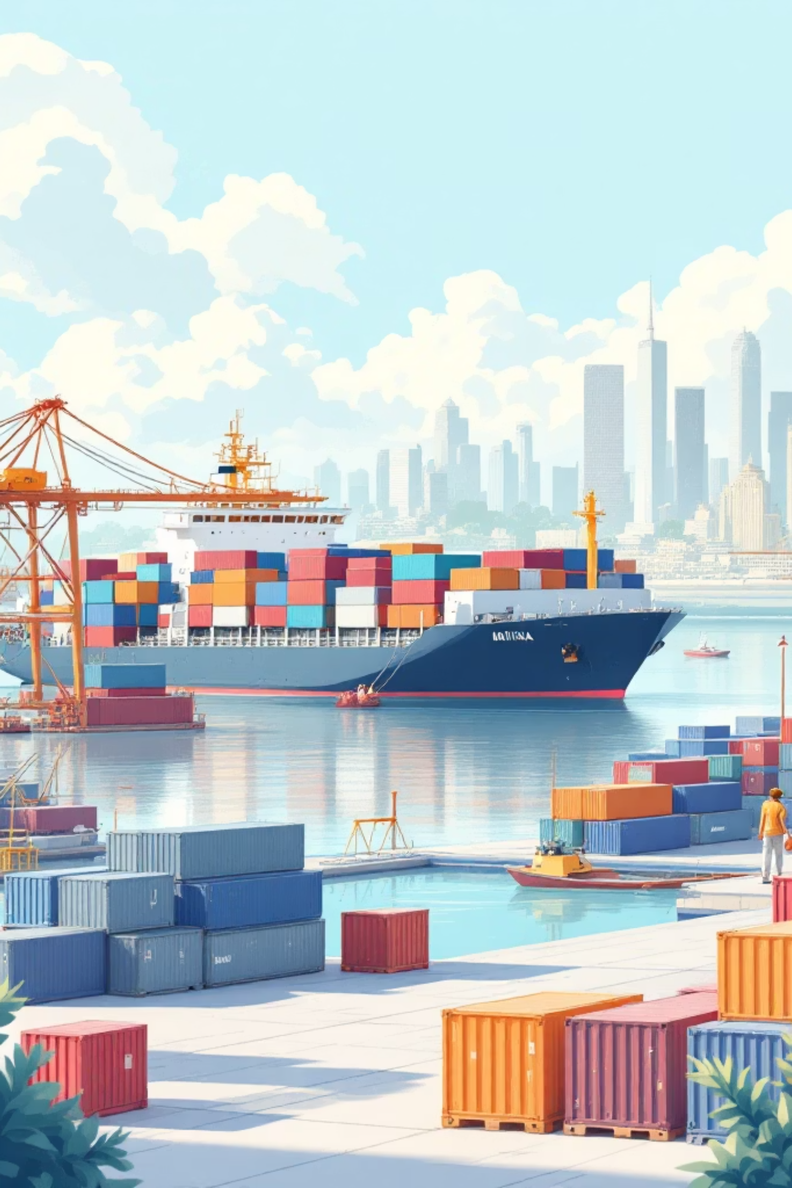
India's Trade Landscape: A Decade of Transformation (2010-2021)
From 2010 to 2021, India's international trade underwent a remarkable evolution. This presentation explores the journey of India's exports and imports, examining key trends, challenges, and the nation's growing footprint in the global marketplace.

Slide 4
The Starting Point: India's Trade in 2010
$220.4B
$350.0B
$119.6B
Total Exports
Total Imports
Trade Deficit
Goods and services shipped worldwide
Essential commodities and raw materials
The initial gap to address
In 2010, India faced a substantial trade deficit while building its export infrastructure. Key trade partners included the United States, China, and the UAE. Dominant export categories featured petroleum products, gems and jewelry, and textiles, while crude oil, machinery, and electronics led imports.

Slide 5
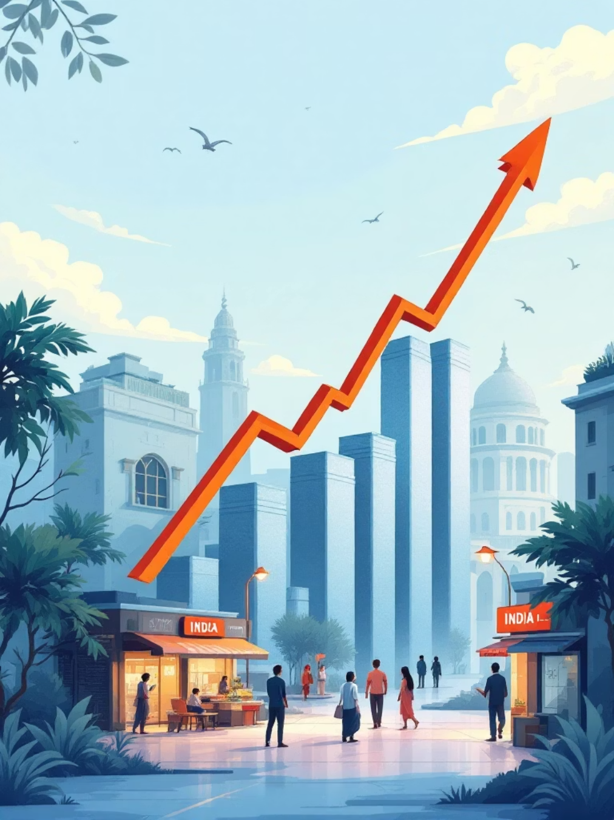



Dramatic Growth: Exports Surge
2010: $220.4 Billion USD
Base year with established manufacturing sectors
Mid-Period Growth
Steady expansion across pharmaceuticals and IT services
2021: $394.8 Billion USD
79% increase, showcasing global market presence
This 79% increase reflects India's expanding role in global trade, driven by competitive advantages in pharmaceuticals, IT services, and manufacturing.

Slide 6
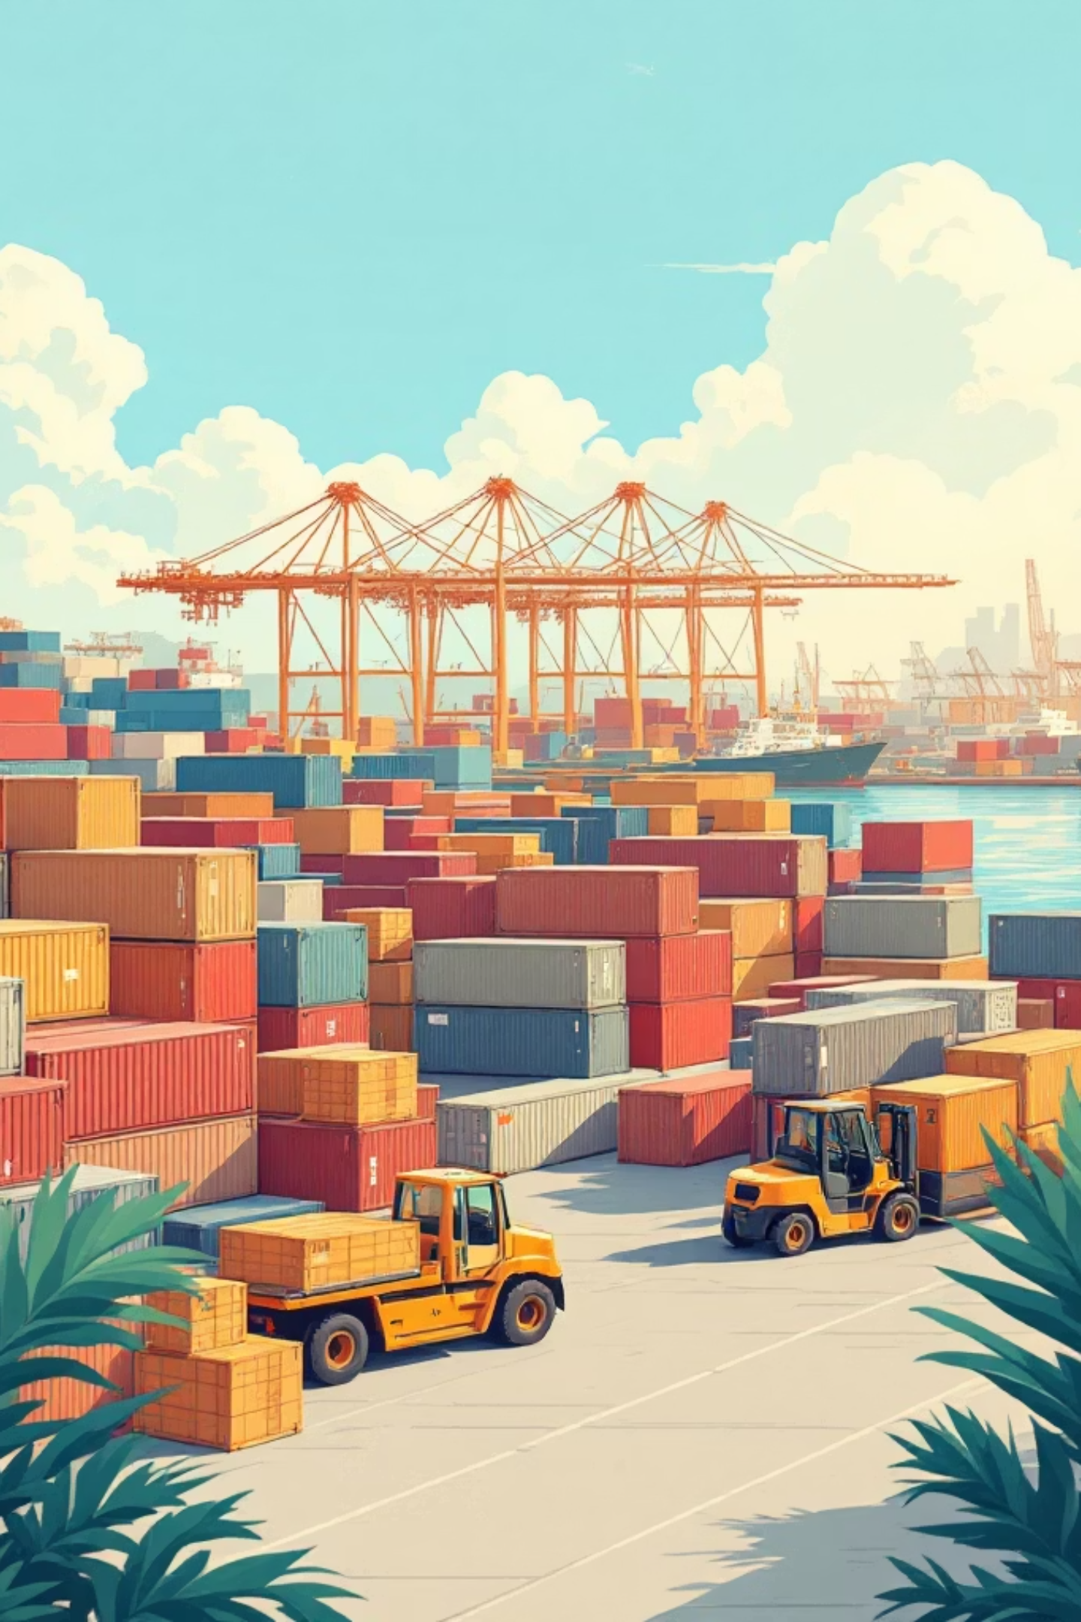

Imports: A Mirror of Economic Activity
Crude Oil Dependency
Industrial Equipment
Primary import category, reflecting energy needs
Machinery and electronics fueling manufacturing growth
Precious Materials
Gems, jewelry, and gold supporting domestic demand
From $350.0 billion in 2010 to $570.4 billion in 2021, imports grew 63%, mirroring India's industrial expansion and rising consumer demand.

Slide 7
The Trade Deficit: A Persistent Challenge
Throughout the decade, India maintained a trade deficit as imports consistently outpaced exports. While the gap widened in absolute terms, strategic initiatives sought to address this imbalance.
2010-2015
2016-2020
2021
Deficit stabilized around $130-150B as export diversification began
Fluctuated with global oil prices and policy changes
Deficit reached $175.6B, prompting renewed export promotion efforts

Slide 8
Shifting Trade Partners: Who are India's Key Allies?
Top Export Destinations
Major Import Sources
United States: Steady growth in pharmaceuticals and IT services
China: Increasing exports of textiles and machinery
UAE: Traditional partner for gems and jewelry
European Union: Diversified product range
China: Dominant source for electronics and machinery
United States: High-tech equipment and aircraft
Saudi Arabia: Crude oil and petroleum products
United Arab Emirates: Precious stones and metals
Trade relationships evolved significantly, with China rising as both a key supplier and competitor, while traditional partners like the US strengthened in specific sectors.

Slide 9

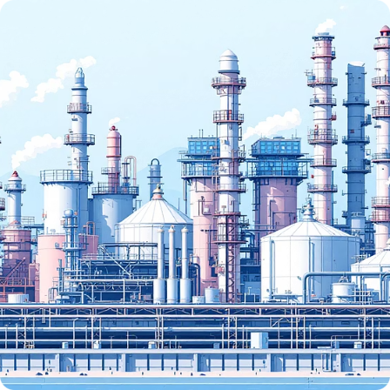

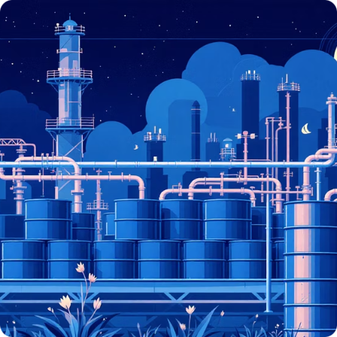

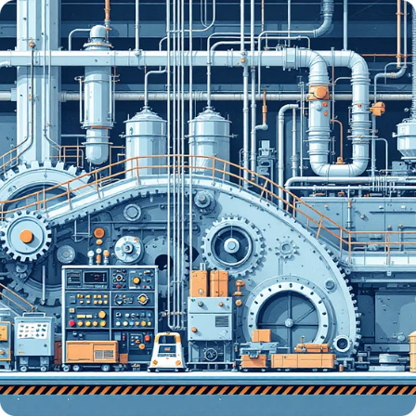
Commodity Spotlight: What India Sells and Buys
Pharmaceuticals
Petroleum Products
Gems & Jewelry
Crude Oil
India's "pharmacy to the world" expanded dramatically, supplying generic medicines globally
Refined products became top export category, leveraging refining capacity
Traditional strength in diamond cutting and gold jewelry exports
Largest import category, meeting growing energy demands
Electronics
Machinery
Smartphones, computers, and components fueling consumer demand
Manufacturing equipment and industrial tools for economic development

Slide 10
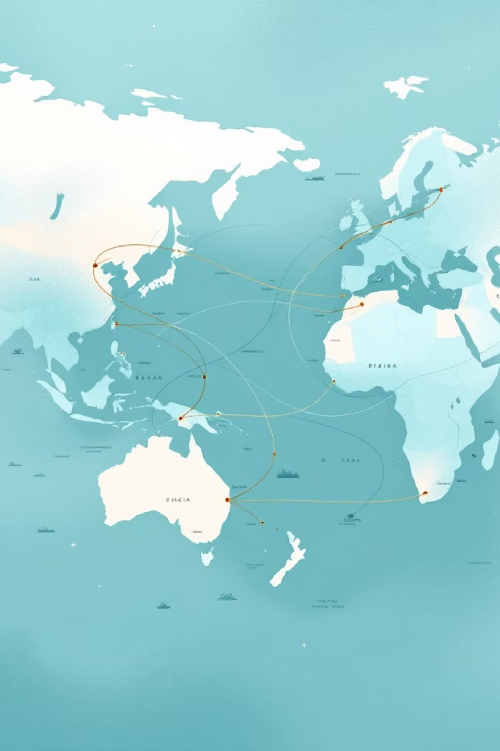
The Impact of Global Events: A Snapshot
1
2010-2012
Post-financial crisis recovery, moderate trade growth
2
2014-2016
Oil price crash reduced import bill temporarily
3
2020-2021
COVID-19 pandemic caused initial disruption, followed by rebound
Global events significantly impacted trade flows. The 2008 crisis aftermath constrained demand initially, while oil price volatility created opportunities. The pandemic's early stages disrupted supply chains but accelerated digital trade adoption.

Slide 11


India's Trade by 2021: A New Era
69%
66%
59%
Export Growth
Import Growth
Deficit Growth
2010-2021 increase
2010-2021 increase
Gap widened proportionally
By 2021, India established itself as a major trading nation with $394.8 billion in exports and $570.4 billion in imports. While the trade deficit remained a challenge, the foundation was set for continued growth and diversification into the next decade.

Slide 12
The Road Ahead: India's Trade Future
01
02
Diversification Strategy
Trade Agreements
Expand beyond traditional sectors into electronics, defense, and renewable energy equipment
Negotiate bilateral and multilateral agreements to reduce tariffs and barriers
03
04
Manufacturing Push
Digital Integration
Production-linked incentives and "Make in India" initiatives to boost exports
Leverage IT and digital services as competitive advantage in global marketplace
The 2010-2021 period demonstrated India's resilience and adaptability in global trade. With strategic focus on value-added exports and reducing import dependency, India is positioned for continued integration into the global economy.

